Slide 1
The Construction of
Causal Schemes
Andrea A. diSessa
UC Berkeley
The Patterns Project: Jeanne Bamberger, Lauren Barth-Cohen, Janet Casperson, Karen Chang, Colleen Lewis, Bradford Hill, Zach Powers, Rozy Brar, Amy Bullis, Emily Chan, Patrick Lee, Sandhya Rao
We gratefully acknowledge support from: The Spencer Foundation.

Slide 2
Preview “Sound Bites”
P-prims and Real-world Learning: A near-complete analysis of an important classroom learning event as a composition of naive knowledge elements. Watching conceptual molecules being built out of conceptual atoms!
Productivity: Document the SPECIFIC usefulness of naive ideas. Exactly what, when, and how.
Mechanisms: New program of empirically abstracted learning mechanisms.

Slide 3
Preview “Sound Bites” continued
Dialectical Approaches to Cognition: Dissolving the “competition” between “social” and “cognitive.”
The analysis of an evidently social event, selected on the basis of social criteria, is made on the basis of individual clinical interviews.

Slide 4
The Patterns Project: Topic
Scientists call it: Dynamical Systems Theory
We call it: Patterns of Change & Control
  Pattern “Vocabulary”: (oscillation, resonance, equilibration, …);
  General “Conceptual Tools”: (Stability/instability; linear/non-linear; attractors; chaos; phase space);
  Inquiry: The Patterns Game

Slide 5
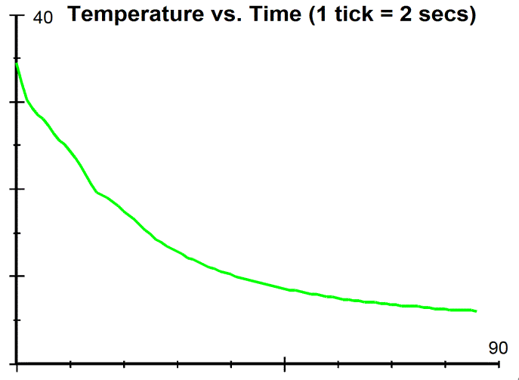
The Goal Conceptualization
Newton’s Law of Cooling
dT/dt = k (T_{Object} – T_{Ambient})

Slide 6
Unit Instructional Design
Open discussion of cold glass of milk taken from the refrigerator.
“Milk” mediated by graphs.
Data collection and analysis.
Scaffolded model creation, in a computer program. (The normative model.)
Extension to other contexts.

Slide 7
Data Selection Criteria
Socially shared: Class consensus; used independently by several, if not all
Stable: Several uses, different contexts

Slide 8
Case Study:
Freaking Out

Slide 9
The Pivotal Event:
(Why does the temperature change faster at first?)
W: I think that the liquids like to be in an equilibrium, so when one is way off they sort of freak out and work harder to reach equilibrium, and when its closer to equilibrium they’re more calm. So they sort of drift slowly towards equilibrium. So maybe that’s why it moves fast at first because it’s like freaking out, but then it slows down because it’s approaching the right temperature.

Slide 10
Intuitive Schemata
(P-prims; diSessa, 1993)
Ohm’s p-prim: “More effort begets more result” (typical result is “amount” or “rate”) – AGENCY
Abstract balance: In certain situations (typically in spatially symmetrical situations), things must balance out.
Abstract imbalance: “Out of balance”

Slide 11
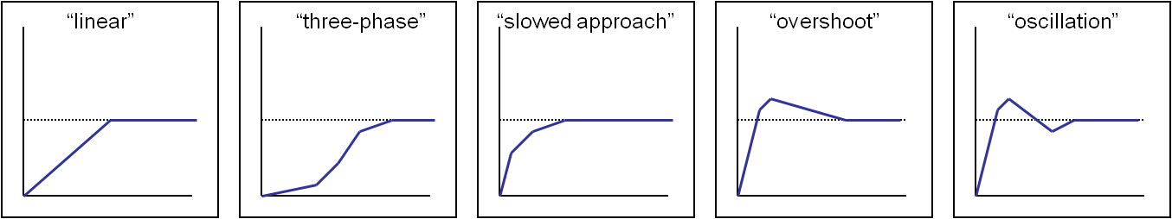
Intuitive Schemata
(Continued…)
4. Equilibration: (return to balance)
  Slowing equilibration
  Overshooting equilibration
NO AGENCY

Slide 12
1. Asserting abstract balance
W: I think that the liquids like to be in an equilibrium, so when one is way off they sort of freak out and work harder to reach equilibrium <and thus go faster> , and when its closer to equilibrium they’re more calm. So they sort of drift slowly towards equilibrium. So maybe that’s why it moves fast at first because it’s like freaking out, but then it slows down because it’s approaching the right temperature.
2. Temperature difference (degree of imbalance) controls…
(created) locus of agency
3. Effort begets rate of change (Ohm’s p-prim)

Slide 13
1. Smaller imbalance
W: I think that the liquids like to be in an equilibrium, so when one is way off they sort of freak out and work harder to reach equilibrium <and thus go faster>, and when its closer to equilibrium they’re more calm. So they sort of drift slowly towards equilibrium. So maybe that’s why it moves fast at first because it’s like freaking out, but then it slows down because it’s approaching the right temperature.
2. Lower agency/effort
3. Lower effort begets lower rate of change (via Ohm’s p-prim)

Slide 14
W: I think that the liquids like to be in an equilibrium, so when one is way off they sort of freak out and work harder to reach equilibrium <and thus go faster>, and when its closer to equilibrium they’re more calm. So they sort of drift slowly towards equilibrium. So maybe that’s why it moves fast at first because it’s like freaking out, but then it slows down because it’s approaching the right temperature.

Slide 15
Out of balance ➔ (Slowing) Equilibration
is replaced by:
Temperature difference (degree of imbalance)
Level of activation (“freaking out”)
Effort (“working harder”)
Result (rate of T. change toward eq.)

Slide 16
Out of balance ➔ (Slowing) Equilibration
is replaced by:
Temperature difference (degree of imbalance)
Level of activation (“freaking out”)
Effort (“working harder”)
Result (rate of T. change toward eq.)
Newton’s law of heating/cooling!

Slide 17
Innovations
Introduction of agency (freaking out)
Control of agency by temperature difference
Ohm’s p-prim to control speed of heating/cooling

Slide 18
Mechanisms
Shift of context. (“agency” is used where none usually perceived)
Composition by causal chaining.
Causal interpolation. (primitive equilibration ➔ causal chain)
Binding. (of world attributes to intuitive scheme attributes; temp diff. ➔ controller-of-agency/effort; “result” ➔ rate of change of temperature)

Slide 19
Mechanisms
What drives the changes (change of context for agency; the particular bindings; the need for causal interpolation)?
5. Emergence (the overall success in explaining a particular problematic situation) Emergence = generation (search) + selection (judgment)

Slide 20
Precursors & Development

Slide 21
W’s agentive equilibration:
The room and the milk are in a “battle to reach dynamic equilibrium,” in which the glass of milk gets “beaten by the room,” and temperatures of both come to match up and “exist in harmony.” “The stronger one affects the weaker one more.”
No social uptake. (Reminiscent of dynamic balance and overcoming—diSessa, 1993)

Slide 22
C’s overshooting equilibration
Very hesitantly: “I recalled in some distant memory <laughing> maybe it would go like this <draws>. It would heat up more than it should, and then go back down to room temperature where it would find its balance.
No social uptake.

Slide 23
W seems to retreat to non-agentive slowing equilibration
No explanation: “The glass goes toward the room temperature quickly at first, but then slows down and slows down. But eventually at a very slow pace it reaches the room temperature.”
No evident social uptake.

Slide 24
R offers slowing equilibration, but adds weak agency and focus on temp. difference in response to “why?”
“Just because it’s such a cold object and such a hot environment that it would just heat up really quickly, because the difference [that] it’s trying to reach equilibrium.”
No social uptake.

Slide 25
R escalates to dramatic agency, “shocked,” during lab.
“The hot water is like shocked […], but, umm, the colder water that you put it into […] causes it to cool down really quickly. But once it’s at a lesser temperature, it starts to slow down as it reaches […].”
R’s lab partner, Z, seems to be in gear.

Slide 26
R aligns her explanation with W’s
“I agree with W, and the way I was trying to describe it was: Once the really cold water gets put into the much warmer water, it experiences like a shock because they’re so drastically different. So it gets closer to that temperature faster in the beginning and stops freaking out and calms down as it approaches equilibrium.”
Growing social uptake.

Slide 27
The teacher re-voices, solicits agreement.
“So it sounds like you guys are saying there’s a lot more freaking out or shock value or something up here <pointing to initial portions of graph> or here, but then as it reaches closer to the equalizing part, the freaking out is less?”
Growing social uptake. “taken as shared”

Slide 28
New context: (very) hot water cools faster than (moderately) cool water warms
W: Maybe that was more degrees hotter than room temperature than the cold one was colder. So, / T: What do you mean by that? / so, it was farther away temperature-wise, like in degrees, from room temperature, which meant it like had a bigger freak out. <Laughter>

Slide 29
…
T: So, what do you mean by farther away?
W: I mean in terms // like, if you had a number line with negative and positives.
T: Can you come up and just draw that for us?
W: The hot temperature is farther away from room temperature than the cold temperature is.
Mathematizing!
C R H

Slide 30
Two days later, another comparison of graphs. The teacher asks why the hot graph is steeper than the cold one.
C: “because the hot one started farther away than the cold one.”
Stripped of anthropomorphism. Elision.

Slide 31
Mechanisms
6. Causal elision (links in the causal chain removed—all links in causal chain, except “temperature difference” ➔ “rate of temperature change”)

Slide 32
Reprise
P-prims and Real-world Learning: A thorough analysis of an important classroom learning event as a composition of naive knowledge elements.
Domain-transcending, abstract elements.
Productivity: Document the SPECIFIC usefulness of naive ideas.
Agentive, directed causality as key insight, NOT primitive or naive.
Mechanisms: New program of empirically abstracted learning mechanisms.

Slide 33
Reprise (continued)
Learning Mechanisms
Macro: Piagetian “equilibration of cognitive structures”; learning by “building coherence”
[- too vague]
Meso: “Knowledge Level” (A. Newell)
[+ tying general mechanisms to content; relatively direct empirical contact]
Micro: Cognitive modeling: Connectionist models, production systems
[- too homogeneous; too generic]

Slide 34
Reprise (continued)
Dialectical Approaches to Cognition:
Understanding complex social events (partially) on the basis of “cognitive” data.
Are phenomena like “social spread,” “consensus,” “participation” beyond the cognitive purview?
Consensus is likely on the basis of confluence of high-priority naïve elements.
Can explain similar or identical, but (quasi-) independent learning trajectories. (escalating anthropomorphism)

Slide 35
Dialectical Approaches to Cognition:
Timidity or confidence are sometimes not personal characteristics or interactional, but knowledge related.
Obvious qualification:
Many aspects of interaction (status, etc.) are not tracked in this analysis.
Notes:
In defense of knowledge

Slide 36
Dialectical Approaches to Cognition:
Final words
Cognitive and Social (participatory) are not “optional,” free-choice perspectives. They are rough ways to direct our attention toward an intimately connected system.
There is knowledge and acquisition in social/interactive issues, also:
Don’t confuse the FOCUS of human performance (social interaction, problem solving) with its NATURE. Social interaction is also on the basis of knowledge, if in unusual forms.
Notes:
In defense of knowledge

Slide 37
The End

